Slide 1

An Interdisciplinary Approach to Improve Care Transitions Through Standardized SDOH Assessment
T
Robyn Floyd MSN, RN
University of Detroit Mercy

Slide 2

Introduction
Veterans dx with SMI are faced with challenges
  Struggle to fit in societal definition of “normalcy”
  Disadvantaged with coping mechanisms of daily life
  Barriers to functionality
  Vulnerable population
  Gaps within care transitioning
  Delusions/Paranoia/Reality
  Shared decision- making inpatient & outpatient

Slide 3

Background
Veterans
  Army
  Marines
  Navy
  Air force
  Coast guard
    Schizophrenia
    Schizoaffective
    Bipolar Disorder
    Major Depression
John Dingell services over 350,000 veterans
Nearly half of all Americans will develop a mental illness in their lifetime (American Hospital Association)
CDC / WHO /VA
  Commitment to reduce health inequities
  Local & National
  Innovation to improve community health

Slide 4

Significance
High Utilization ER & Inpatient Psych
Avg 3-12 (ER) Avg 2-3 (ADM)
Identification of risk
Need of community resource
Communication
Collaboration
Engagement
Adherence
Sustainability
Patient/family/caregiver
Reduction of social & moral inequities

Slide 5
Organizational Assessment
Chart Audit
  SMI veterans with high-utilization
  Inclusion 2>hospitalizations or ER visits within one year
27 veterans identified
  10 to 36 days hospitalization
  3-12 emergency room visits
22% of identified veterans assessed for SDOH risk
Healthcare leaders are driving assessment of SDOH to reduce inequity
Organizational goals
  Reduce cost
  Reduce waste
  Reduce high-utilization

Slide 6

Clinical Question
Does an interdisciplinary approach to assessing and planning for SDOH risk improve satisfaction among the discharge team and SMI veteran population?
Does the implementation of a SDOH tool during the early phases of discharge planning reduce ER visits & re-hospitalization for veterans with SMI?

Slide 7
Literature Review
Health Literacy
Provider Ed
Community Engagement
Collaboration/Shared Decision Making
Access Failures/Social Fragility
Social Support
Treatment Planning
Barrier

Slide 8
Purpose Statement
Develop an interdisciplinary care transition team
  Develop
  Implement
  Evaluate
  Identify a process for assessing SDOH risks
  Improve communication & discharge practices
  Improve ER visits
  Improve re-hospitalizations
  Improve veteran satisfaction responses

Slide 9
Theoretical Framework
A3 Tool A3 Tool Model
Transition Care Model
Donabedian Model

Slide 10
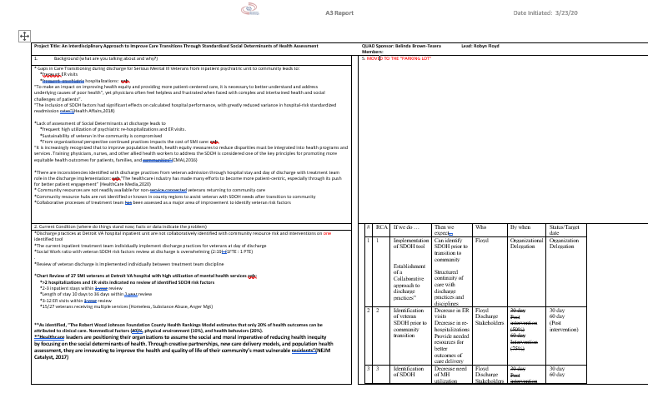
A3 Tool

Slide 11
Methodology
Design
Quality Improvement
Participants
SMI Veterans, male & female, ages 31-70, inpatient psych,
2-week pilot project
Tools
SDOH Risk Assessment Tool
Veteran Satisfaction
Employee Satisfaction
IRB Approval
WSU/VA
UDM
n=18

Slide 12
Methodology
Intervention
2-Week Pilot Program
QI Discharge Practices of ICTT
Pre and Post Intervention Data

Slide 13
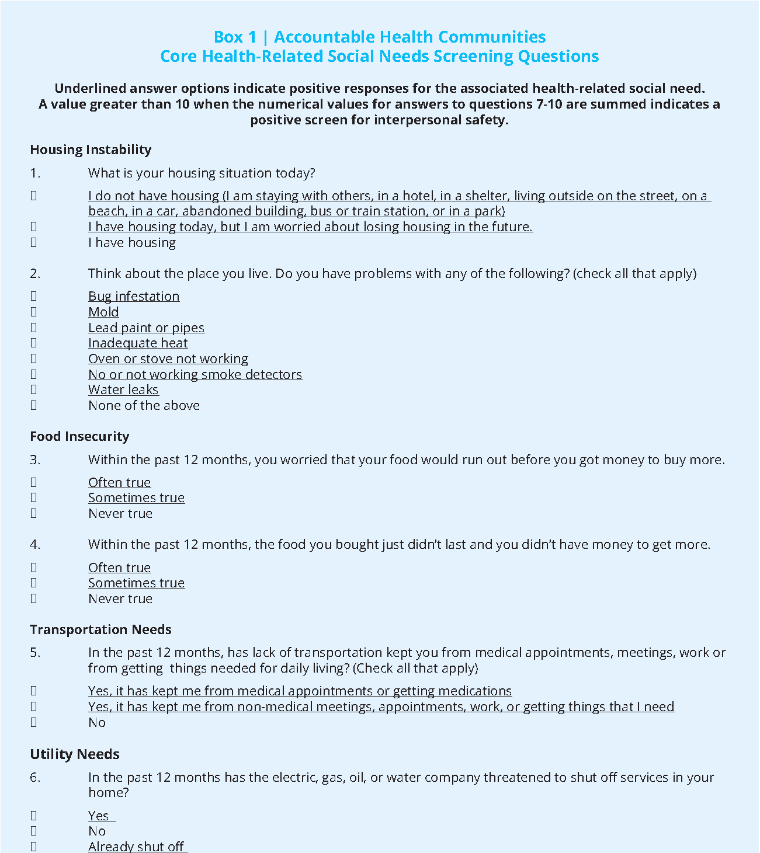
SDOH Risk Assessment Tool

Slide 14

Analysis

Slide 15
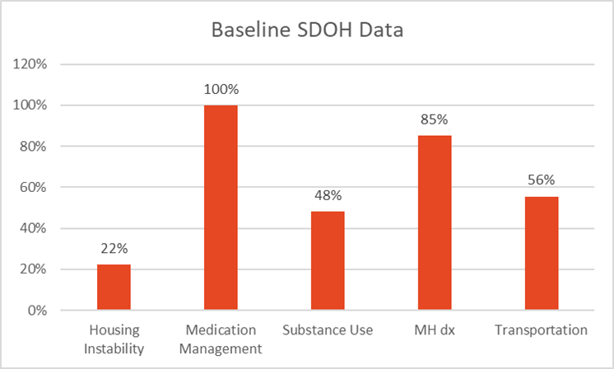
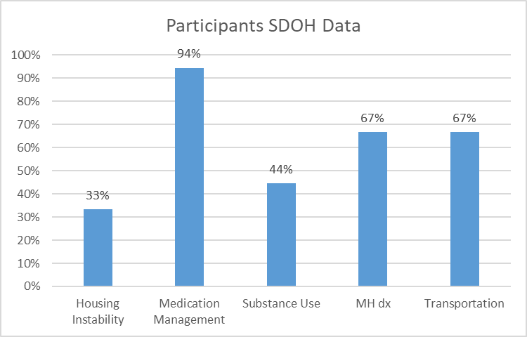
Social Determinants of Health
Chart Audit (n=27)
Pilot Participants (n=18)

Slide 16
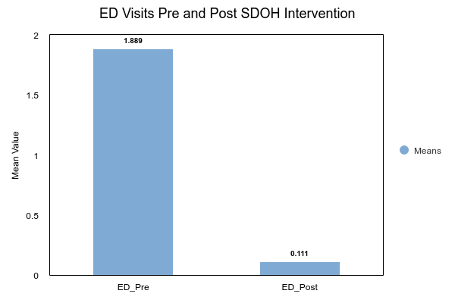
ED VISITS
70-day post intervention
Non-parametric Two-tailed Wilcoxon Signed Rank Test
  Examine significant difference between pre and post ED
  Significant based on an alpha value of 0.05, V=153.00,z=3.70,p<.001

Slide 17
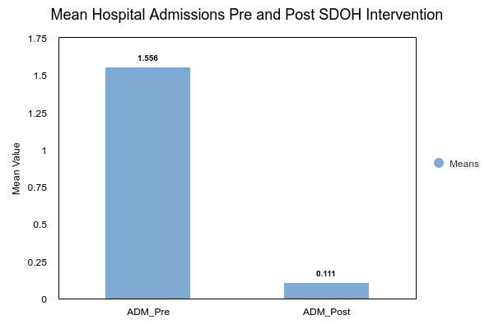
Hospital Admissions
70-day post-intervention
Two-tailed Wilcoxon signed rank test were significant based on alpha value of: 0.05, V=171.00,z=3.84,p<001

Slide 18
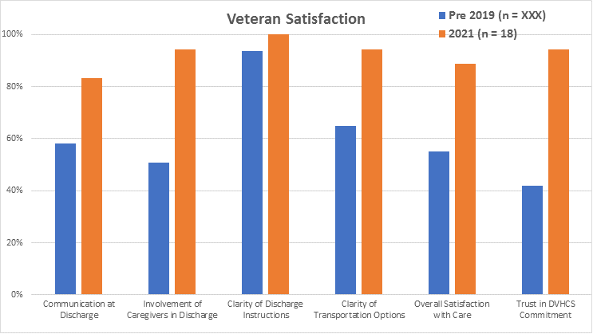
Veteran Satisfaction
Veteran Satisfaction
Pre and Post Survey
Independent t-test: p-value is < .00001

Slide 19
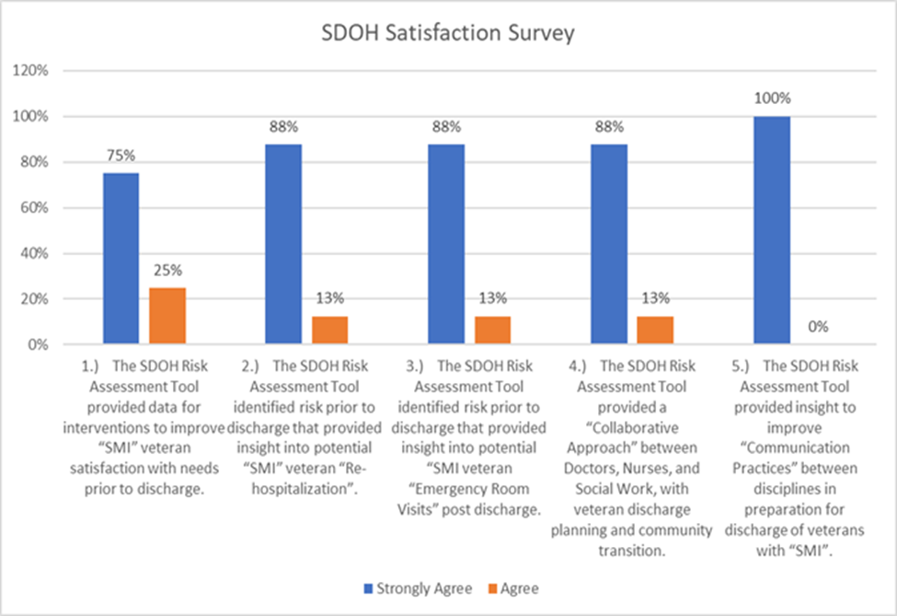
Employee Satisfaction
ICTT Survey
ICTT Survey Results

Slide 20
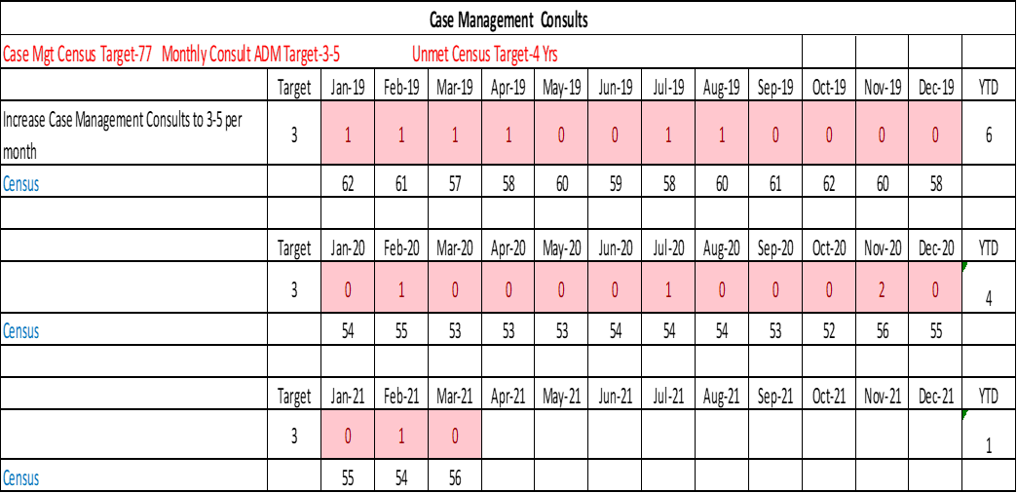
Incidental Finding

Slide 21
Discussion
SDOH risk assessment early in discharge
  reduce re-hospitalization 70-day post discharge
  Reduce ER visits 70 days discharge
  Improve veteran and employee satisfaction
Healthcare practices to provide safe transitions of veterans
  Identify social needs of veteran prior to discharge
Joint commission patient safety goals (safe handoff)
Cost savings

Slide 22
Sustainability
Present findings to leadership
Present post data findings to ICTT inpatient unit
Discuss sustainability of SDOH tool in early discharge planning
Propose a Care Transition Team
Provide open door policy with ICTT to continue QI discharge practices
Incorporate project practices and education to future Care Transition initiatives
Dissemination

Slide 23
Implications for Practice
Strategic planning
  Veteran
  Inpatient & Outpatient Treatment Teams
  Case Management
  Family
  Community resources
Identify need of case management services prior to discharge
Continuous improvement of processes and addressing variables that lead to high-utilization

Slide 24


ACKNOWLEDGEMENTS
Project Committee
Dr. Karen Mihelich (Chair)
Dr. Burson (DNP Advisor)
Belinda Brown-Tereza (JDDVA Chief Executive Nurse)
Marla Gresham (Mental Health Chief Nurse)
B2 North ICTT
JDDVA Education & Statistical Staff
My Family & RACC Family
T

Slide 25
References
Social Determinants of Health. (2017). NEJM Catalyst. Retrieved from https://www.catalyst.nejm.org.
Andermann, A.. (2016). Taking action on the social determinants of health in clinical practice: a framework for health professionals, 188(474-483).
Artiga, S., & Hinton, E. (2018). Beyond Health Care: The Role of Social Determinants in Promoting
Health and Health Equity. KFF Foundation. Retrieved from https://www.kff.org.
NCHHSTP Social Determinants of Health. (2020). Centers for Disease Control. Retrieved fromhttps://www.cdc.gov.
John D. Dingell VA Medical Center, Detroit, Michigan. (2021). Retrieved from https://www.detroit.va.gov.

