Slide 1
Using Virtual Remote Monitoring as an Alternative Observation Method for
Suicidal Patients
Doug Dascenzo, MSN, RN, CENP

Slide 2
Introduction
Virtual remote monitoring is one method by which hospitalized patients in the United States are observed for safety reasons (AvaSure, 2019).
Virtual remote monitoring requires the use of a mobile or fixed camera in the patient’s room that transmits real-time visual feedback to a remote central workstation staffed by a virtual monitoring technician. The technology might also include intercom, duress alarm, and privacy capability (AvaSure, 2019).
This method of patient safety surveillance has predominantly been used to observe patients at high risk for falls with the goal of keeping them safer, as evidenced by a reduction in injurious falls (AvaSure, 2019).
This quality improvement initiative is intended to replicate the work conducted at Brigham and Women’s Hospital in which virtual remote monitoring was used to provide observation to hospitalized adult patients screening positive for suicide at low or medium risk and low impulsivity (Kroll et al., 2019).

Slide 3
Background
Every adult suicidal patient presenting to St. Joseph Mercy Oakland hospital is immediately assigned to an in-person sitter to provide constant observation until active suicide precautions are discontinued.
The need for constant observation in this patient population is sporadic and often challenging to provide just in time. Frequently, nurse assistants or those occupying other higher-paid positions are used to supplement the need until additional sitter resources can be identified and secured, thereby shortchanging other patients and their nurses of staffing support.
The annual sitter cost at St. Joseph Mercy Oakland is $2.3M and trending upward year-over-year (M. Corbat, personal communication, January 23, 2020).
In conjunction with the rollout of a standard virtual remote monitoring platform, Trinity Health ministries are expected to reduce in-person sitter utilization by 50% within one year (M. Boyd, personal communication, August 18, 2020).

Slide 4
Significance
According to the American Foundation for Suicide Prevention, suicide is the 10th leading cause of death in the United States (American Foundation for Suicide Prevention, 2019, November 4).
The incidence of suicide in hospitals ranges from 48.5 to 64.9 annually (Williams, Schmaltz, Castro, & Baker, 2018).
Though the annual number of hospital suicides is relatively low, it is classified as a “serious reportable event” or “never event” by the National Quality Forum and subjected to regulatory review by the Centers for Medicare and Medicaid Services with potentially dire consequences to accreditation, program integrity, community trust, and finances, including fines (National Quality Forum, 2011).

Slide 5
Problem Statement
An adult patient at low or medium risk for suicide residing on the general medical floor outside the inpatient psychiatric unit currently requires the assignment of an in-person sitter to provide constant observation until active suicide precautions are discontinued. This quality improvement initiative is intended to assess the use of virtual remote monitoring as an alternative to the traditional method and its effects on patient health and well-being, cost, and experience of care (Kroll et al., 2019).

Slide 6
Literature Review
The predominance of the evidence in this review revealed three major elements germane to this work including:
  Evidence-based suicide risk assessment tools and impulsivity scales (Zun & Downey, 2008; Giddens, Sheehan, & Sheehan, 2014; Grant & Lusk, 2015; Simpson, Pidgeon, & Nordstrom, 2017; Abarca, Gheza, Coda, & Elicer, 2018; TJC, 2018; Kroll et al., 2019);
  Incidence of suicidal and non-suicidal self-injury (Anestis & Selby, 2015; Sahlin, Moberg, Hirvikoski, & Jokinen, 2015; TJC, 2018; Williams, Schmaltz, Castro, & Baker, 2018; AvaSure, 2019) ; and
  Constant observation (Russ, 2016; TJC, 2018; Chu, Lambert, & Baker, 2019; Kroll et al., 2019)

Slide 7
Purpose Statement
The overarching aim of the project was to determine the degree to which virtual remote monitoring may be an acceptable alternative to the constant observation method traditionally deployed for hospitalized adult patients on suicide watch, which includes the assignment of an individual sitter to each suicidal patient until active suicide precautions are discontinued.

Slide 8




Theoretical Framework
The Quality-Caring Model©, a middle-range theory developed by Duffy is the theoretical framework selected to support a replication study as described by Kroll et al. (2019). The theory’s foundation is based on the works of Watson (Theory of Human Caring) and Donabedian (Quality Model: Structure-Process-Outcomes) (Butts & Rich, 2018).

Slide 9
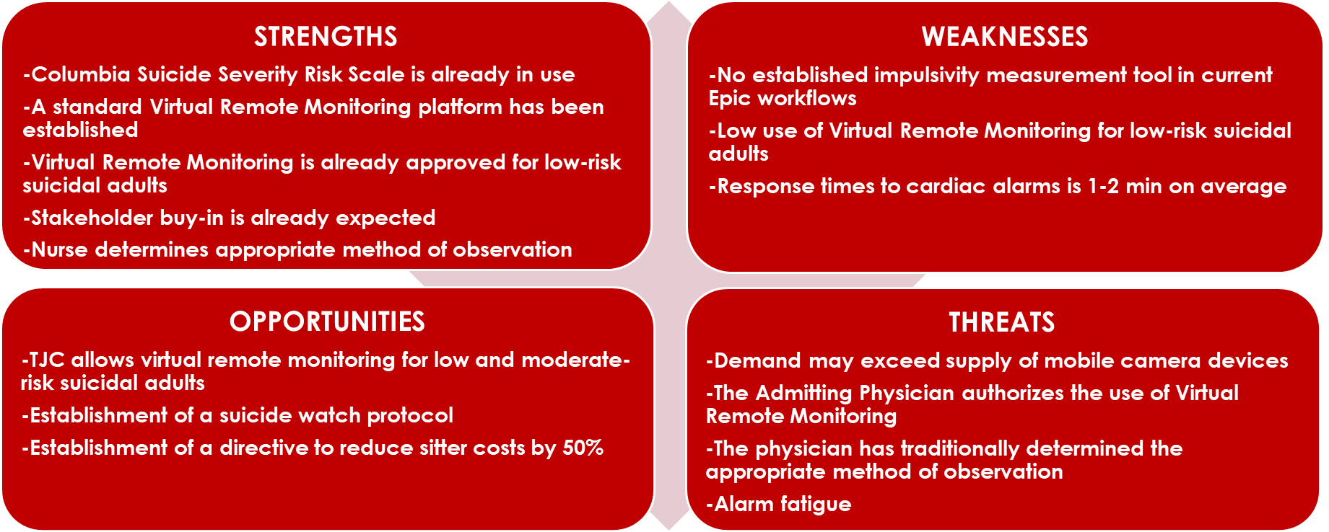
Organizational Assessment

Slide 10
Method/Design
Design: Quality Improvement initiative
Intervention: Virtual Remote Monitoring
Sample: Convenience
Target population: Low and medium-risk suicidal adult patients residing outside the inpatient psychiatric unit with low impulsivity (includes Medical-Surgical, Critical Care, and Physical Medicine & Rehabilitation; excludes ED)
Regulatory requirements: 360-degree view of clinical area, continuous observation capability, and mechanism to produce an immediate response to imminent danger
Suicide observation protocol: Included evidence-based suicide risk assessment and impulsivity tools, i.e., C-SSRS, BARS, and Virtual Remote Monitoring vs. traditional in-person sitter options

Slide 11
Method/Design
Project management oversight team: Established to drive the changes necessary to ensure a successful and sustainable implementation; stakeholders included the medical director of psychiatry, service line director, clinical nurse specialist, nursing education coordinator, nurse manager of Logistics, chief medical officer, and chief nursing officer; met weekly to assess each phase of the implementation, analyze data, identify challenges, and formulate plans of correction
No video recording was permitted
Patients were made aware of camera surveillance and had the right to refuse

Slide 12
Method/Design
OUTCOME MEASUREMENTS
Establish a suicide observation protocol that describes inclusion/exclusion criteria for Virtual Remote Monitoring (structure)
Utilize the full Columbia-Suicide Severity Rating Scale to stratify suicide risk (process)
Incorporate the use of an impulsivity scale, i.e., BARS, for patients at low or medium risk for suicide (process)
Determine the incidence of patient harm utilizing Virtual Remote Monitoring vs. the traditional assignment of individual sitters to provide observation (outcome)
Compare/contrast the cost of care related to the use of Virtual Remote Monitoring vs. the traditional method of constant observation (outcome)
Assess caregiver experience (outcome)

Slide 13
Method/Design
Descriptive and inferential statistical analyses were conducted.
IRB
The IRB application was submitted and approved by St. Joseph Mercy Health System and Mercy Health (SJMHS/MH) and the University of Detroit Mercy.

Slide 14
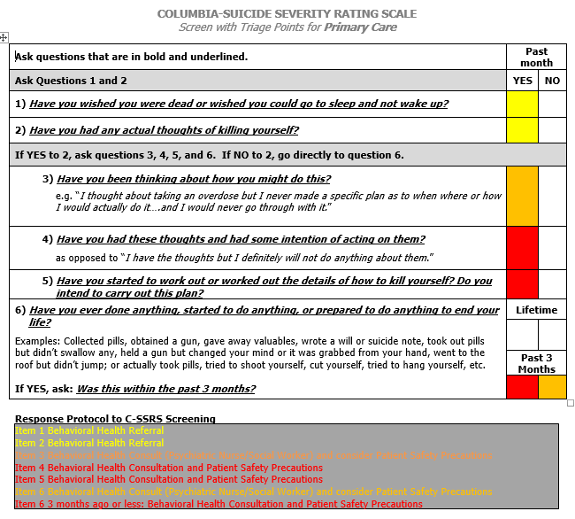
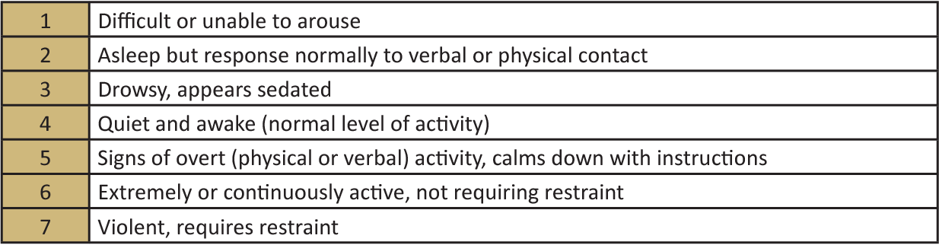
Tools
Columbia-Suicide Severity Rating Scale (C-SSRS)
Behavioral Activity Rating Scale (BARS)
(Simpson, S., Pidgeon, M., & Nordstrom, K., 2017)
(The Columbia Lighthouse Project, 2016)

Slide 15
Nurse Preference Survey
Survey to assess nurses’ preferences for method of observation
Your alias (first 4 letters of the street name you grew up on followed by the month of your birthday in MM format):
Patient MRN:
Type of monitoring received (check all that apply):
___1:1 observation ___Continuous Virtual Monitoring (CVM) Other___________
Please respond to the following statements according to a scale ranging from 1 to 5, with 1 meaning you “strongly disagree” and 5 meaning “strongly agree.”
1. I felt comfortable that the patient being monitored for suicide precautions was safe.
1 2 3 4 5
strongly disagree disagree neutral agree strongly agree
2. The patient being monitored for suicide precautions caused trouble for me.
1 2 3 4 5
strongly disagree disagree neutral agree strongly agree
3. It took a lot of time for me to care for the patient who was monitored for suicide precautions.
1 2 3 4 5
strongly disagree disagree neutral agree strongly agree

Slide 16
4. The patient on suicide precautions could have done something to harm himself or herself, and there is nothing I could have done about it.
1 2 3 4 5
strongly disagree disagree neutral agree strongly agree
5. Having the patient monitored for suicide precautions was easy for me.
1 2 3 4 5
strongly disagree disagree neutral agree strongly agree
6. The patient’s behavior remained calm and appropriate while on suicide precautions.
1 2 3 4 5
strongly disagree disagree neutral agree strongly agree
7. I would choose that this patient has 1:1 observation rather than a continuous virtual monitoring.
1 2 3 4 5
strongly disagree disagree neutral agree strongly agree
8. I would choose that this patient has continuous virtual monitoring rather than 1:1 observation.
1 2 3 4 5
strongly disagree disagree neutral agree strongly agree
(Kroll et al., 2019)

Slide 17
Results
Time period: January 14 – May 14, 2021
20 of 36 patients were deemed appropriate for virtual remote monitoring (VRM) or 1,752 VRM hours (38.4%) vs. 2,808 in-person hours (61.6%).
Safety
VRM-associated adverse events = 0
Sitter-associated adverse events = 0

Slide 18
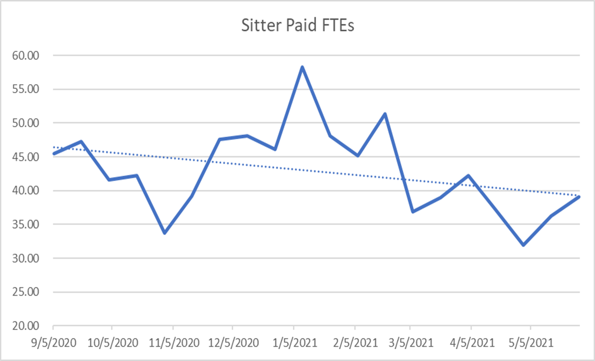

Results
Cost of Care
Average reduction in FTE usage/pay period = 8.2 FTEs
Annualized cost savings less infrastructure expense = $357,000

Slide 19
Results
Nurse Preference
68 respondents: 44 utilized VRM and 24 constant observation (CO)
5-point scale: 1 = strongly disagree; 2 = disagree; 3 = neutral, 4 = agree; 5 = strongly agree
Practical significance of the differences between the two groups were reflected by small effect size for three of the items:
I felt comfortable that the patient being monitored for suicide precautions was safe (VRM Mdn = 3.42; CO Mdn = 4.40; η² = 0.11)
I would choose that this patient has continuous virtual monitoring rather than 1:1 observation (VRM Mdn = 2.17; CO Mdn = 1.45; η² = 0.11)
I would choose that this patient has 1:1 observation rather than continuous virtual monitoring (VRM Mdn = 4.14; CO Mdn = 4.68; η² = 0.07)

Slide 20
Results
The responses to the other five items (concerned with issues relating to the patients’ behavior; ease of monitoring, harm to the patients, time taken for monitoring, and trouble with patients) indicated similar low to neutral levels of disagreement among both the constant observation and VRM groups, with negligible effect sizes.

Slide 21
Discussion
Virtual remote monitoring may be a safe and cost-effective solution for adult suicidal patients who meet specified inclusion criteria.
Though nurses preferred in-person sitting over virtual remote monitoring, a clearly defined suicide observation protocol along with a gatekeeper ensures appropriate adoption of the technology.

Slide 22
Implications and Conclusions
Nurse preference for in-person sitting over virtual remote monitoring may have been influenced by the condition of the patient as well as a lack of familiarity, comfort, and confidence in the technology and procedures established to ensure safety.
Based on small sample size and limited experience with established structural and process elements, additional studies over multiple short-term acute care facilities are recommended.
In addition to ensuring patient safety, virtual remote monitoring may also provide for increased staff safety as evidenced by reports of contraband brought into the patient care environment by visitors.
Suicidality is temporal and as such needs to be re-assessed using standard tools at a pre-determined frequency.
Establishing an enterprise-wide virtual remote monitoring platform in conjunction with support for its use by The Joint Commission ensures sustainability.

Slide 23
Implications and Conclusions
This quality improvement initiative has been accepted for a poster presentation at the 2021Fourteenth National Doctors of Nursing Practice Conference. Additionally, a manuscript is being prepared for submission to the Journal of Nursing Administration.
The lessons learned from this project are intended to serve as the foundation for extending the use of the suicide observation protocol including virtual remote monitoring in the emergency department where a disproportionate number of resources continue to be used to achieve similar outcomes. This quality improvement work is expected to become the focus of another DNP project.

Slide 24
Acknowledgements
Project Chair: Rosanne Burson DNP, APRN, CNS-C, CNE, CDCES, FADCES, FNAP
Reader: Renay Gagleard, DNP, MSN, CNS-C, RNBC
Corresponding Author: David S. Kroll, MD
Medical Director, Department of Psychiatry: Davinder Kakar, MD
Clinical Nurse Specialist: Kaylin Suppon, MSN, RN, AGCNS-BC
Director of Operations: Marcy Corbat, MHSA
Director of Nursing: Amy McIntosh, MSN, RN
Statistician: Ron Fisher, PhD

Slide 25
References
Abarca, C., Gheza, C., Coda, C., & Elicer, B. (2018). Literature review to identify standardized scales for assessing adult suicide risk in the primary health care setting. Medwave, 18(5), e7246. https://doi.org/10.5867/medwave.2018.05.7246
American Association of Colleges of Nursing. (2006). The Essentials of Doctoral Education for Advanced Nursing Practice. AACN. https://www.aacnnursing.org/Portals/42/Publications/DNPEssentials.pdf
American Foundation for Suicide Prevention (2019, November 4). Suicide statistics. https://afsp.org/about-suicide/suicide-statistics/
Amrhein, V, Greenland, S., & McShane, B. (2019). Scientists rise up against statistical significance. Nature, 567,305–307. https://www.nature.com/articles/d41586-019-00857-9
Anestis, M.D., & Selby, E.A. (2015). Grit and perseverance in suicidal behavior and non-suicidal self-injury. Death Studies, 39(4), 211-218.
AvaSure (2019). New clarity for video monitoring on suicide risk patients. https://www.avasure.com
Berwick, D.M., Nolan, T.W., & Whittington, J. (2008). The triple aim: care, health, and cost. Health Affairs, 27(3), 759-769. https://doi.org/10.1377/hlthaff.27.3.759

Slide 26
References
Butts, J.B., & Rich, K.L. (2018). Philosophies and Theories for Advanced Nursing Practice. 3rd edition. Sudbury, M.A: Jones & Bartlett. ISBN 9781284112245.
Chassin, M., & Loeb, J. (2013). High-reliability health care: getting there from here. The Milbank Quarterly, 91(3), 459-490.
Chu, S., Lambert, K., & Baker, A. (2019). What to look for during constant observations: Expert consensus and a tool for observations recording. Journal of Psychiatric and Mental Health Nursing. https://doi.org/10.1111/jpm.12555
Duffy, J. (2005). Implementing the quality-caring model© in acute care. JONA, 35(1), 4-6.
Duffy, J., & Hoskins, L.M. (2003). The Quality-Caring Model: blending dual paradigms. Advances in Nursing Science, 26(1), 77-88.
Enders, C. (2010). Applied missing data analysis. New York, NY: Guildford Press.
Ferguson, C. J. (2016). An effect size primer: A guide for clinicians and researchers. In: A. E. Kazdin (Ed.). Methodological issues and strategies in clinical research (p. 301–310). American Psychological Association. https://doi.org/10.1037/14805-020
Gelman, A., & Hennig, C. (2017). Beyond subjective and objective in statistics. Journal of the Royal Statistical Society, 180(4), 966-1033. https://doi.org/10.1111/rssa.12276

Slide 27
References
Giddens, J.M., Sheehan, K.H., & Sheehan, D.V. (2014). The Columbia-Suicide Severity Rating Scale (C-SSRS): has the “gold standard” become a liability? Innovations in Clinical Neuroscience, 11(9-10), 66.
Grant, C.L., & Lusk, J.L. (2015). A multidisciplinary approach to therapeutic risk management of the suicidal patient. Journal of Multidisciplinary Healthcare, (8), 291-298.
Hayat, M., Staggs, V.S., Todd, A., Schwartz, T.A., Higgins, M., & Azuero, A. (2019). Moving nursing beyond p < .05. International Journal of Nursing Studies, 42, 244-245. https://doi.org/10.1016/j.injurstu.2019.05.012
Kroll, D.S., Stanghellini, E., DesRoches, S.L., Lydon, C., Webster, A., O’Reilly, M., Hurwitz, S., Aylward, P.M., Cartright, J.A., McGrath, E.J., Delaporta, L., Meyer, A.T., Kristan, M.S., Falaro, L.J., Murphy, C., Karno, J., Pallin, D.J., Schaffer, A., Shah, S.B., Lakatos, B.E., Mitchell, M.T., Murphy, C.A., Gorman, J.M., Gitlin, D.F., & Mulloy, D.F. (2019). Virtual monitoring of suicide risk in the general hospital and emergency department. General Hospital Psychiatry. https://doi.org/10.1016/j.genhosppsych.2019.01.002
Leppink J, Winston K, & O’Sullivan P. (2016). Statistical significance does not imply a real effect. Perspectives on Medical Education, 5, 122–144. https://doi.org/10.1007/s40037-016-0256-6
Mattick, K., Johnston, J. & de la Croix, A. (2018). How to…write a good research question. The Clinical Teacher, 15 (2), 104-108. https://doi.org/10.1111/tct.12776

Slide 28
References
Mental Health Code Act 258. Michigan Mental Health Code Ꝣ 330.1425. (1974). http://legislature.mi.gov/doc.aspx?mcl-330-1425
Mental Health Code Act 258. Michigan Mental Health Code Ꝣ 330.1724. (1974). http://legislature.mi.gov/doc.aspx?mcl-330-1724
Michigan Department of Health & Human Services. (2016). Your Rights When Receiving Mental Health Services in Michigan. C:/Users/gzmf2770/AppData/Local/Microsoft/Windows/INetCache/IE/RPTCCGTO/RightsBooklet_9716_7.pdf
National Quality Forum. (2011). Serious Reportable Events. http://www.qualityforum.org/topics/sres/serious_reportable_events.aspx
Russ, M.J. (2016). Constant observation of suicidal patients: the intervention we love to hate. Journal of Psychiatric Practice, 22(5), 382-388.
Sahlin, H., Moberg, T., Hirvikoski, T., & Jokinen, J. (2015). Non-suicidal self-injury and interpersonal violence in suicide attempters. Archives of Suicide Research, 19(4), 500-509.
Sessler, C.N., Gosnell, M.S., Grap, M.J., Brophy, G.M., O’Neal, P.V., Keane, K.A., Tesoro, E.P., & Elswick, R.K. (2002). The Richmond Agitation-Sedation Scale: validity and reliability in adult intensive care unit patients. American Journal of Respiratory Critical Care Medicine, 166, 1338-1344. http://doi.org/10.1164/rccm.2107138

Slide 29
References
Sikka, R., Morath, J.M., & Leape, L. (2015). The quadruple aim: care, health, cost, and meaning in work. BMJ Quality & Safety, 24(10), 608-610. http://dx.doi.org/10.1136/bmjqs-2015-004160
Simpson, S., Pidgeon, M., & Nordstrom, K. (2017). Using the Behavioral Activity Rating Scale as a vital sign in the psychiatric emergency service. Semantic Scholar. https://www.semanticscholar.org/paper/Using-the-Behavioural-Activity-Rating-Scale-as-a-in-Simpson-Pidgeon/c5d1dcf2e90e7a3c783133043866c7573f10cc0d#paper-header
Sullivan, G.M., & Feinn, R. (2012). Using effect size—or why the p value is not enough. Journal of Graduate Medical Education, 4(3), 279-282.
The Columbia Lighthouse Project. (2016). The Columbia protocol for healthcare and other community settings. https://cssrs.columbia.edu/the-columbia-scale-c-ssrs/cssrs-for-communities-and-healthcare/#filter=.general-use.english
The Joint Commission. (2018). R3 report issue 18: national patient safety goal for suicide prevention. https://www.jointcommission.org/r3_report_issue_18_national_patient_safety_goal_for_suicide_prevention/
The Michigan Penal Code Act 328. Michigan Compiled Laws Ꝣ 750.539d. (1931). http://legislature.mi.gov/doc.aspx?mcl-750-539d

Slide 30
References
Utley, R., Henry, K., & Smith, L. (2018). Frameworks for Advanced Nursing Practice and Research: Philosophies, Theories, Models and Taxonomies. New York: Springer Publishing Company. ISBN 9780826133229.
Votruba, L., Graham, B., Wisinski, J., & Syed, A. (2016). Video monitoring to reduce falls and patient companion costs for adult inpatients. Nursing Economics, 34(4), 185-189.
Wasserstein, R.L., & Lazar, N.A. (2016). The ASA's Statement on p-values: Context, process, and purpose. The American Statistician, 70, 129-133. https://doi.org/10.1080/00031305.2016.1154108
Wasserstein, R., Schirm, A.L., & Lazar, N.A. (2019). Moving to a world beyond “p < 0.05”. The American Statistician, 73, 1-9. https://doi.org/10.1080/00031305.2019.1583913
Williams, S.C., Schmaltz, S.P., Castro, G.M., & Baker, D.W. (2018). Incidence and method of suicide in hospitals in the United States. The Joint Commission Journal on Quality and Patient Safety. https://doi.org/10.1016/j.jcjq.2018.08.002
Zaccagnini, M.E., & Pechacek, J.M. (2020). A template for the DNP project. In M.E. Zaccagnini & J.M. Pechacek (Eds.), The Doctor of Nursing Practice Essentials (4th ed., pp. 349-397). Jones & Bartlett Learning.
Zun, L.S., & Downey, L.A. (2008). Level of agitation of psychiatric patients presenting to an emergency department. The Primary Companion to The Journal of Clinical Psychiatry, 10(2), 108-113. https://doi.org/10.4088/PCC.v10n0204

